Slide 1
2024 Bayesian Modelling Workshop
Seungjae Lee
Department of Civil & Mineral Engineering
University of Toronto
July 30, 2024

Slide 2
Workshop Outline
Measurement uncertainty and Bayesian estimation
Bayesian linear regression
Latent/unobservable variables
Advanced Topics: Design of Experiment and Optimization

Slide 3
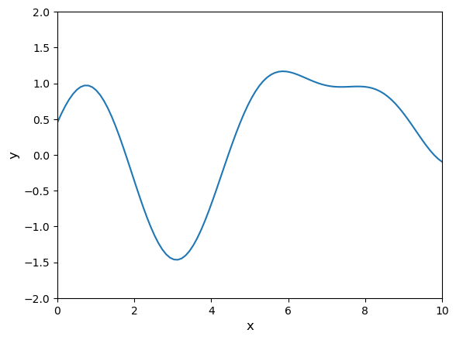
Bayesian Design of Experiment

Slide 4
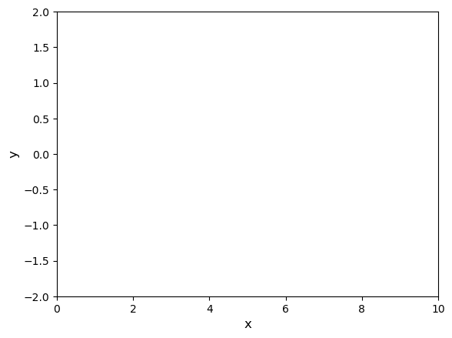
Bayesian Design of Experiment

Slide 5
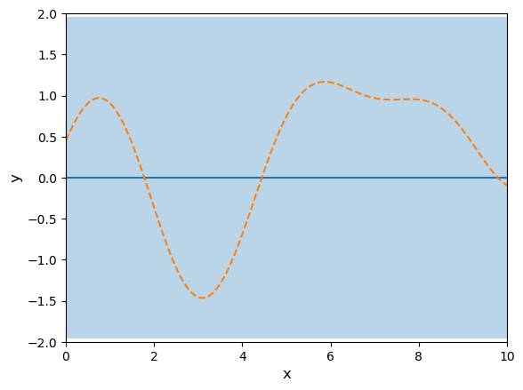
Bayesian Design of Experiment

Slide 6

Bayesian Design of Experiment

Slide 7
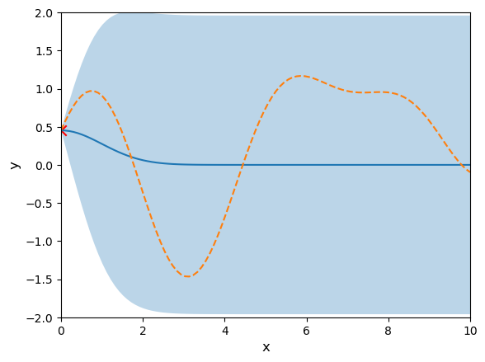
Bayesian Design of Experiment

Slide 8
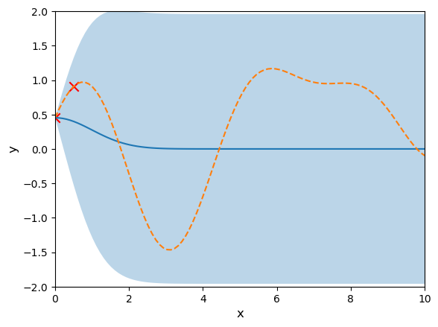
Bayesian Design of Experiment

Slide 9
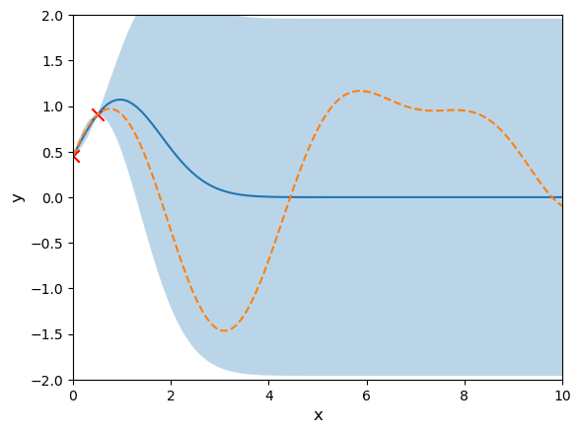
Bayesian Design of Experiment

Slide 10
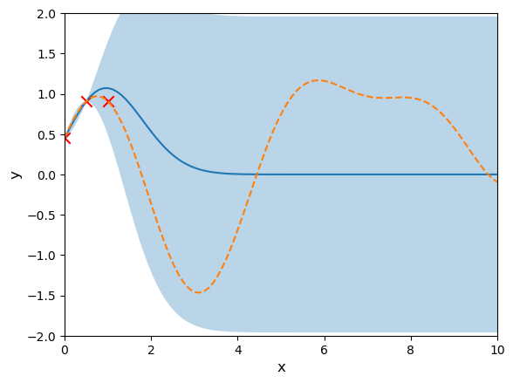
Bayesian Design of Experiment

Slide 11
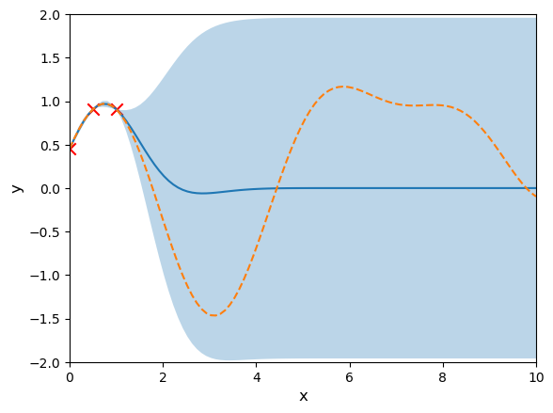
Bayesian Design of Experiment

Slide 12
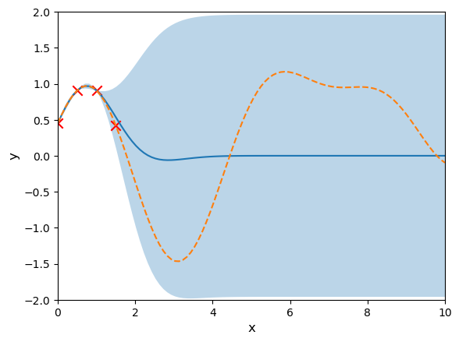
Bayesian Design of Experiment

Slide 13
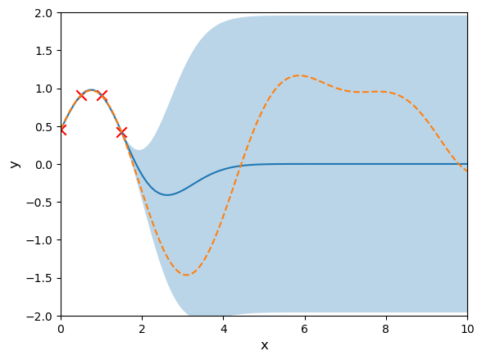
Bayesian Design of Experiment

Slide 14

Bayesian Design of Experiment

Slide 15
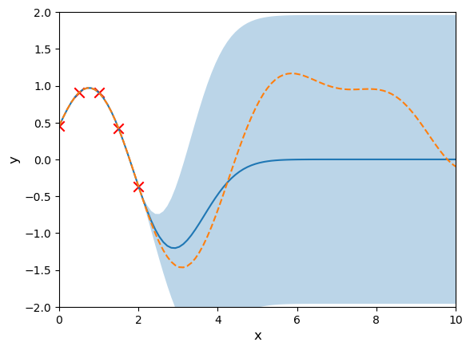
Bayesian Design of Experiment

Slide 16
Bayesian Design of Experiment
My experiment is very very expensive!
Is there a better way to design experiments?

Slide 17
Bayesian Design of Experiment

Slide 18
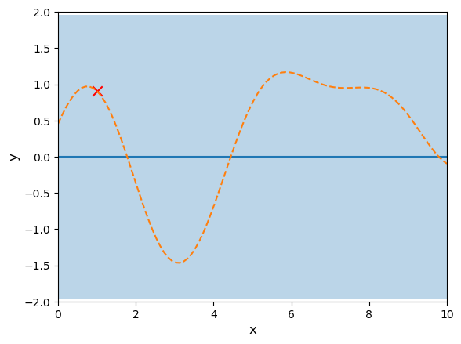
Bayesian Design of Experiment

Slide 19
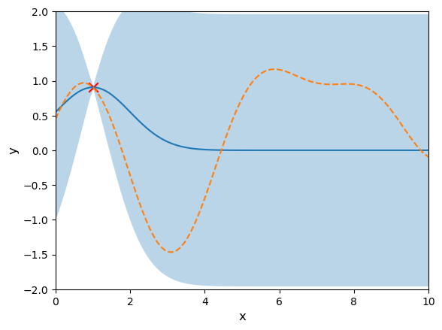
Bayesian Design of Experiment

Slide 20

Bayesian Design of Experiment

Slide 21
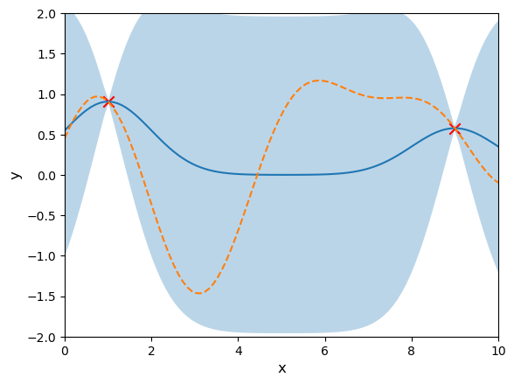
Bayesian Design of Experiment

Slide 22

Bayesian Design of Experiment

Slide 23
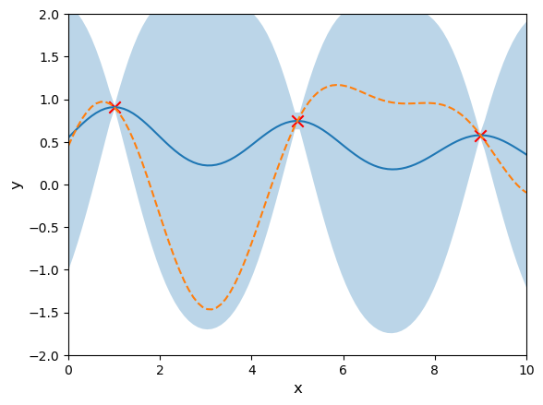
Bayesian Design of Experiment

Slide 24

Bayesian Design of Experiment

Slide 25
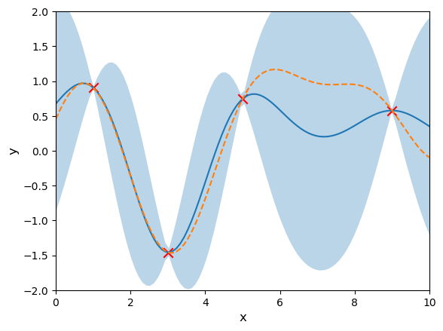
Bayesian Design of Experiment

Slide 26
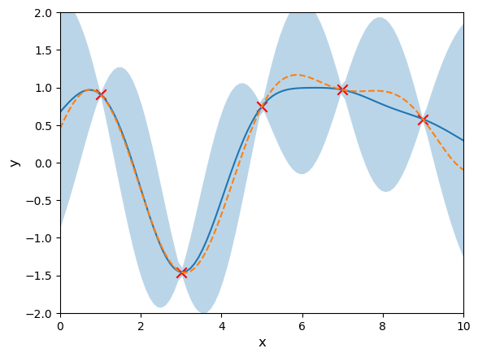
Bayesian Design of Experiment

Slide 27
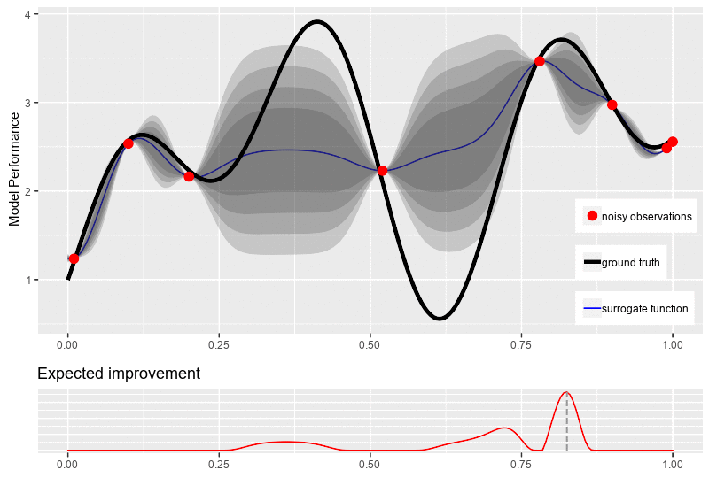
Bayesian Optimization

Slide 28
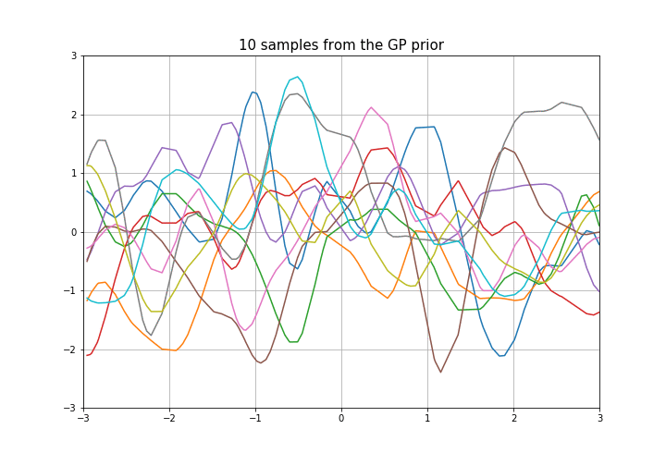
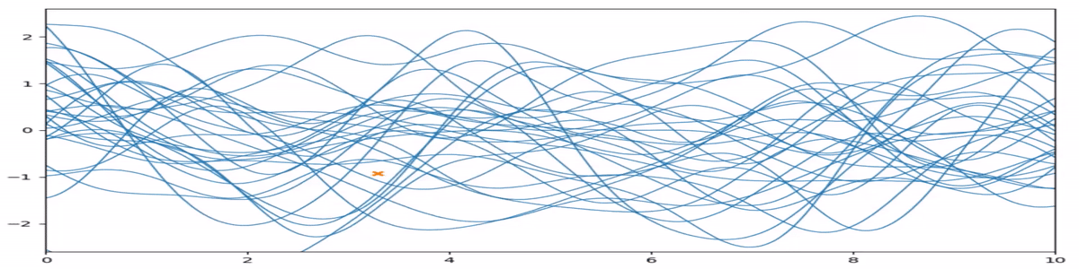
Gaussian Process
In probability theory and statistics, a Gaussian process is a stochastic process (a collection of random variables indexed by time or space), such that every finite collection of those random variables has a multivariate normal distribution

Slide 29
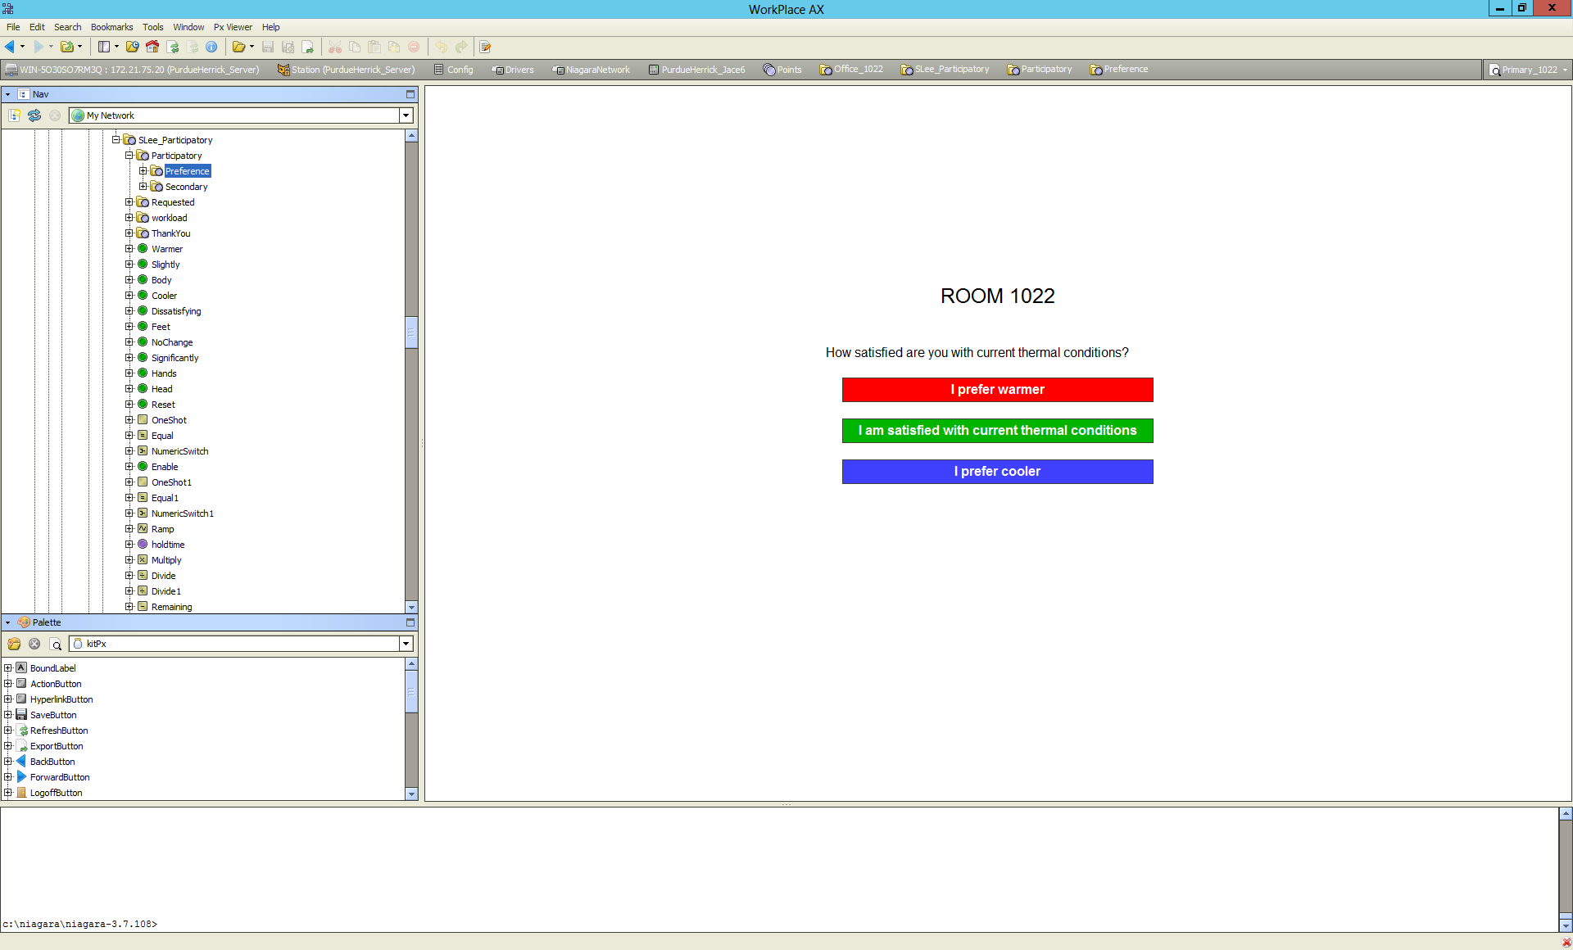
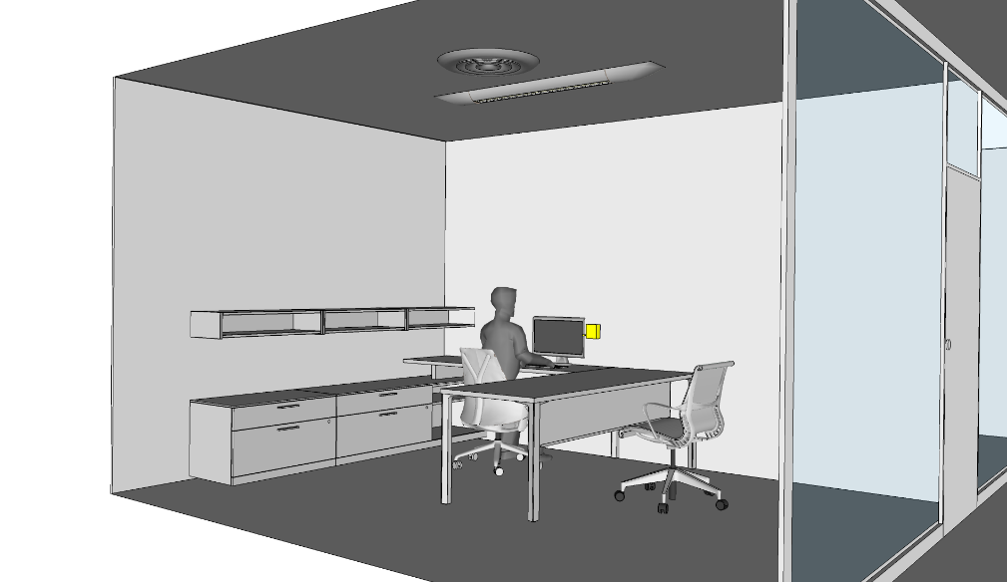

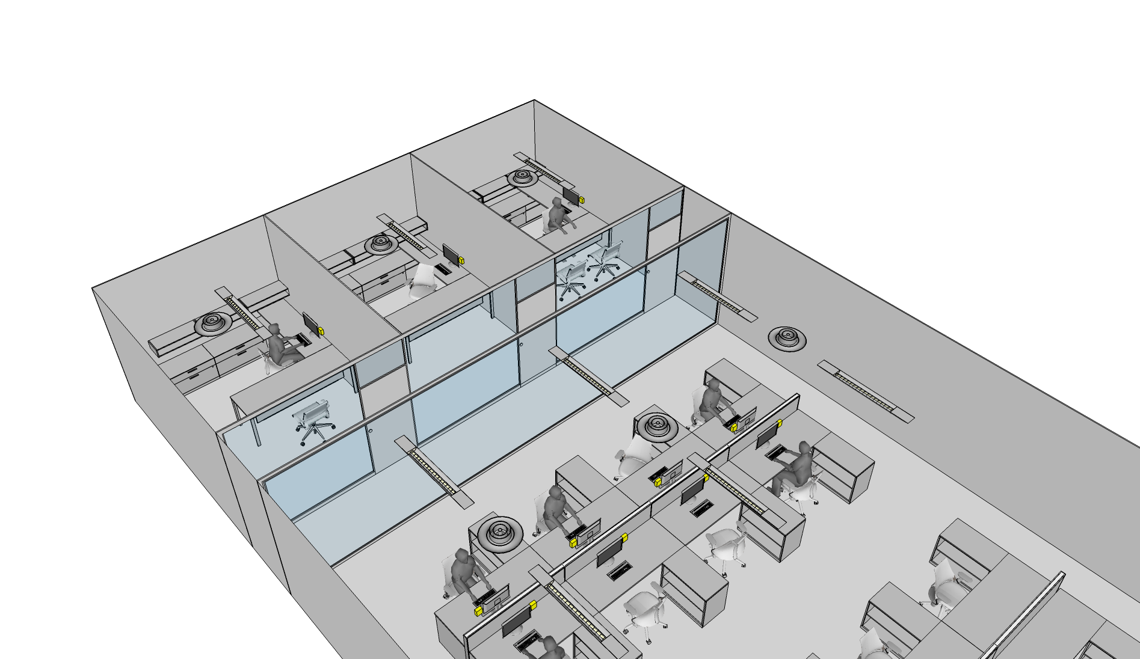
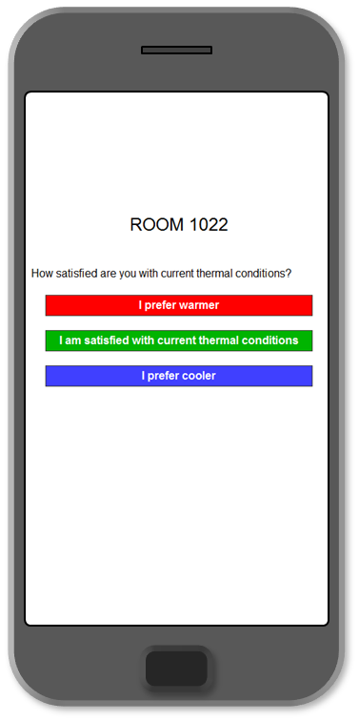
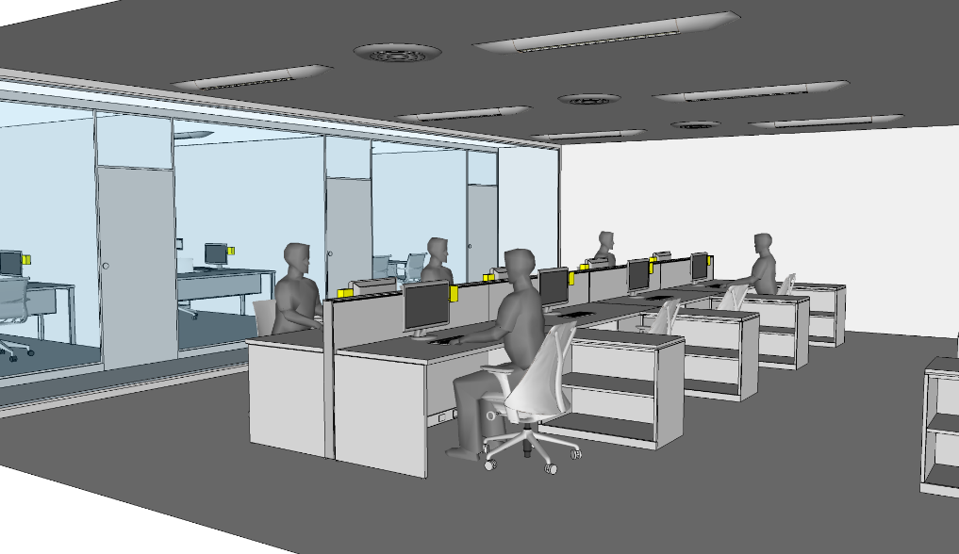
Smart Interface
Private Office
Learning Module
- Occupant Preferences
- Occupancy Schedule
- Occupant Behavior
Data Handling
- Weather
- Indoor Conditions
- Occupancy
- Occupant Feedback
- System Status
- Utility Price
Weather
Energy Grid
Local Sensing
- Temperature
- Occupancy
- Physiological Info.
Control Module
- Stochastic Opt. Control
- Multi-Agent Architecture
- Distributed Optimization
Open-plan Office
Sensor Data
Occupant Feedback

Slide 30
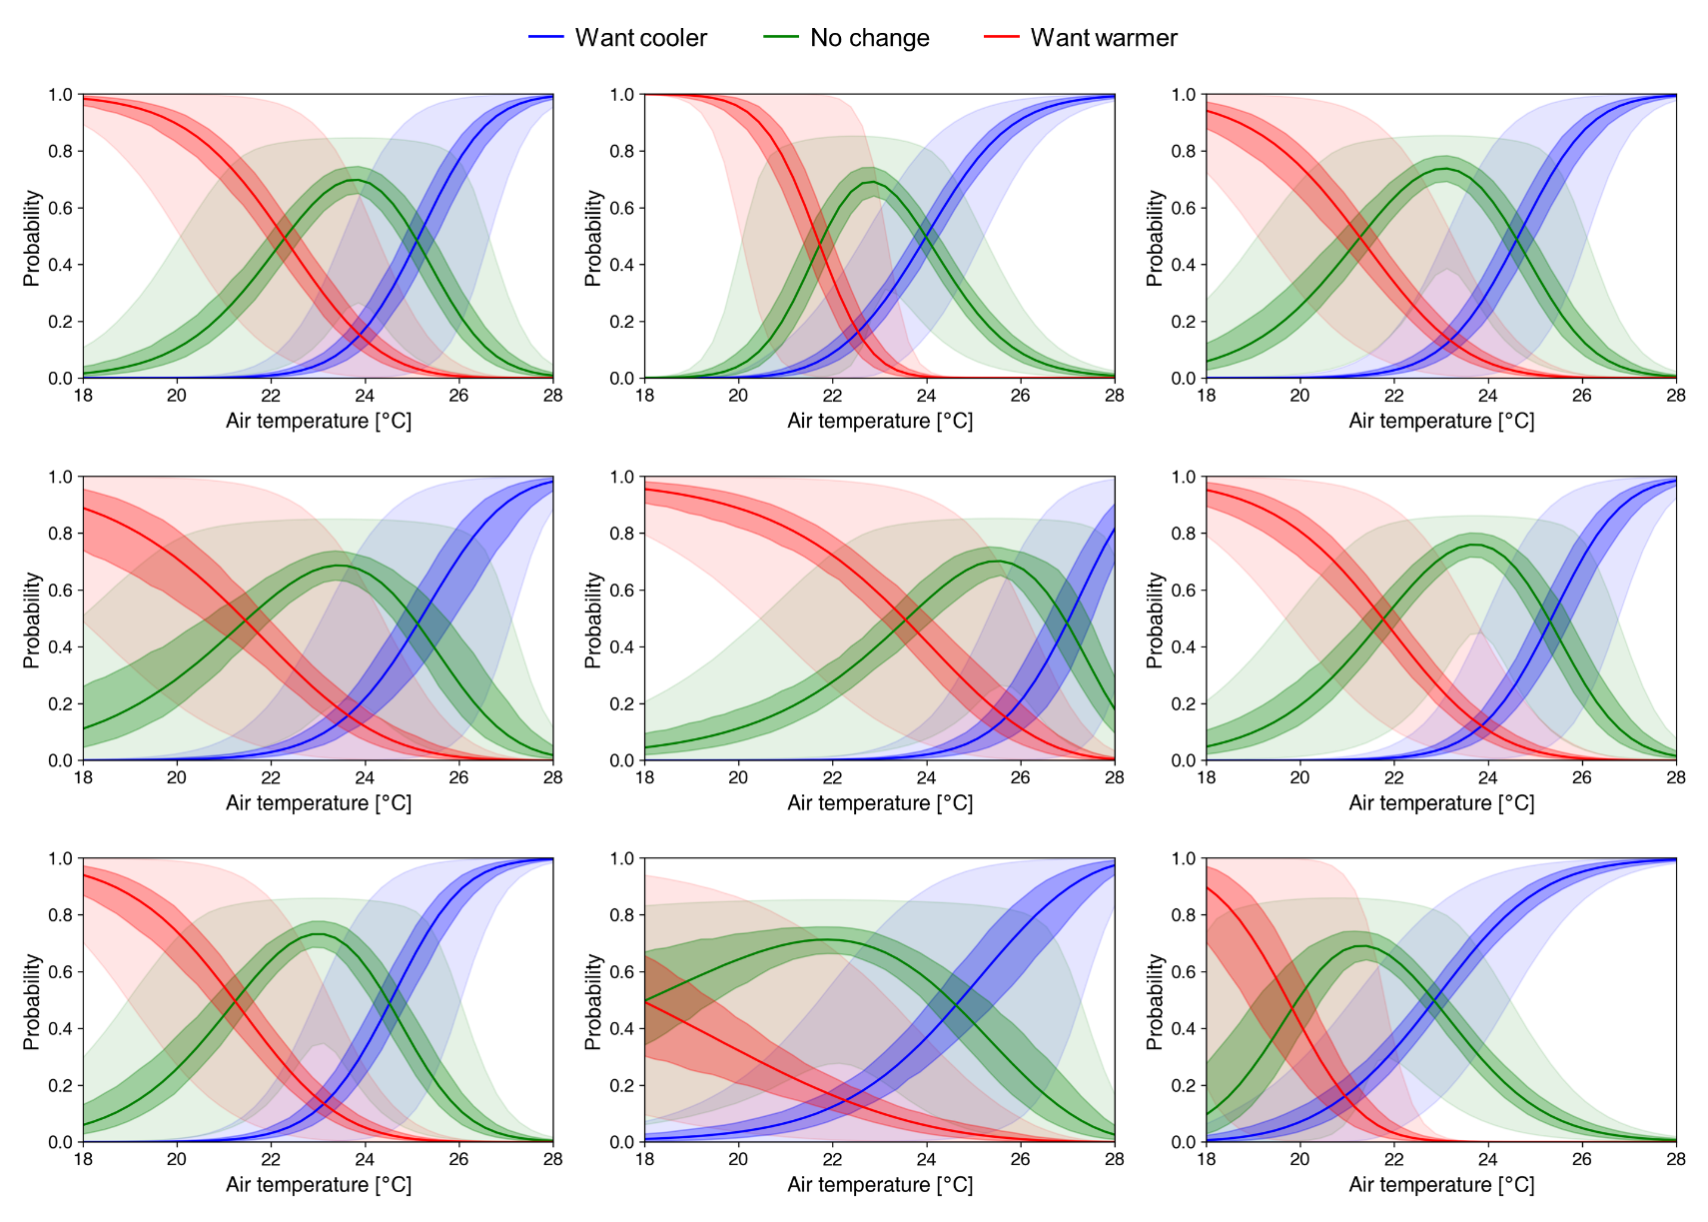
Smart Interface

Slide 31
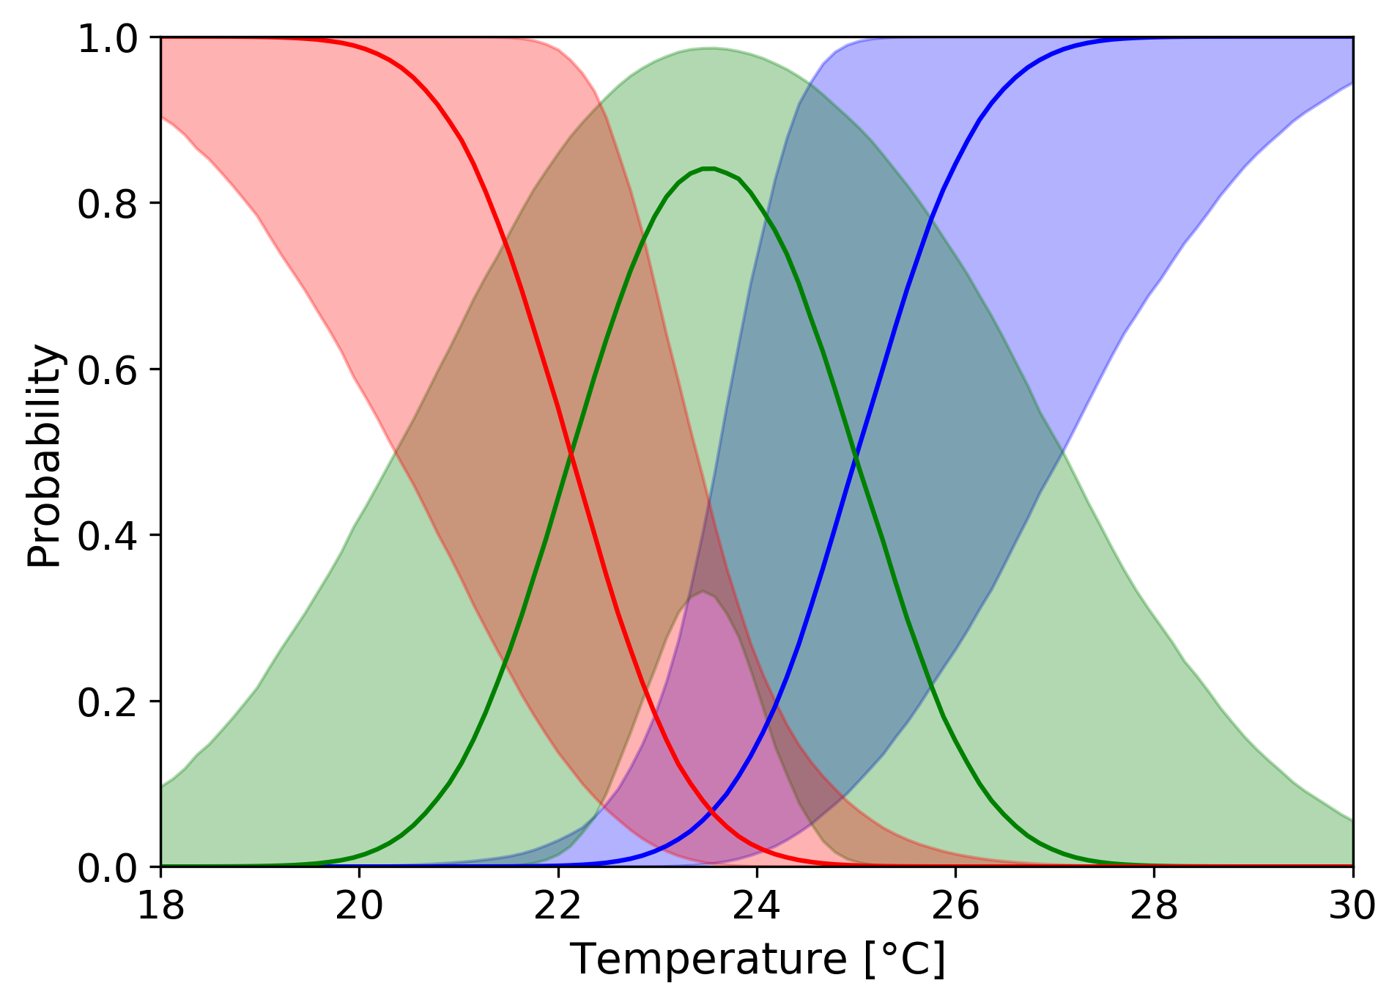
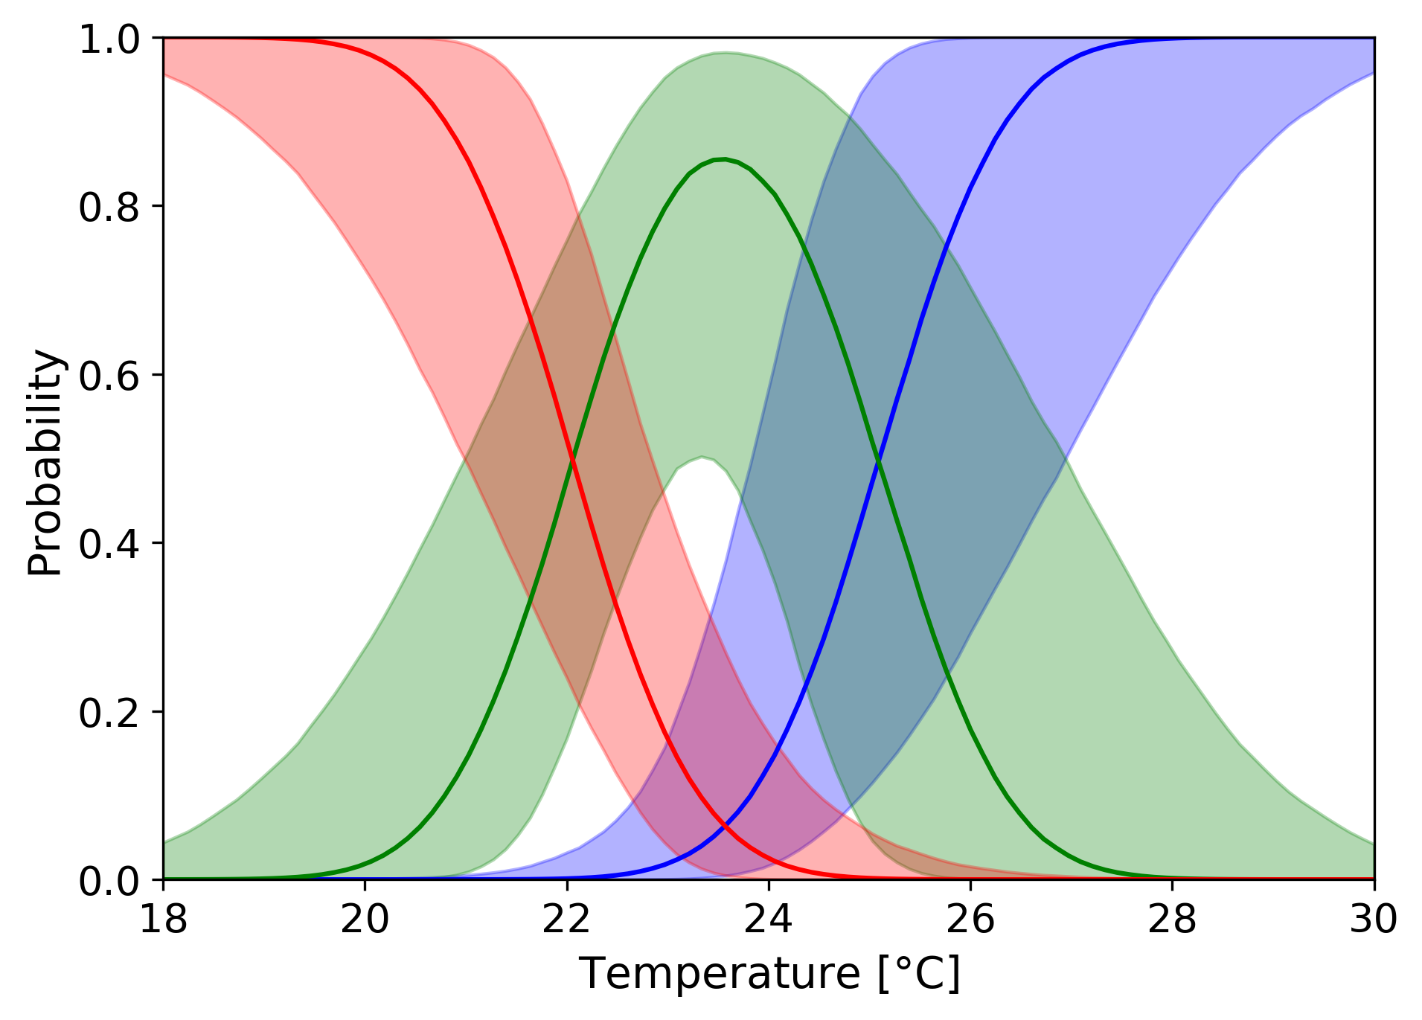
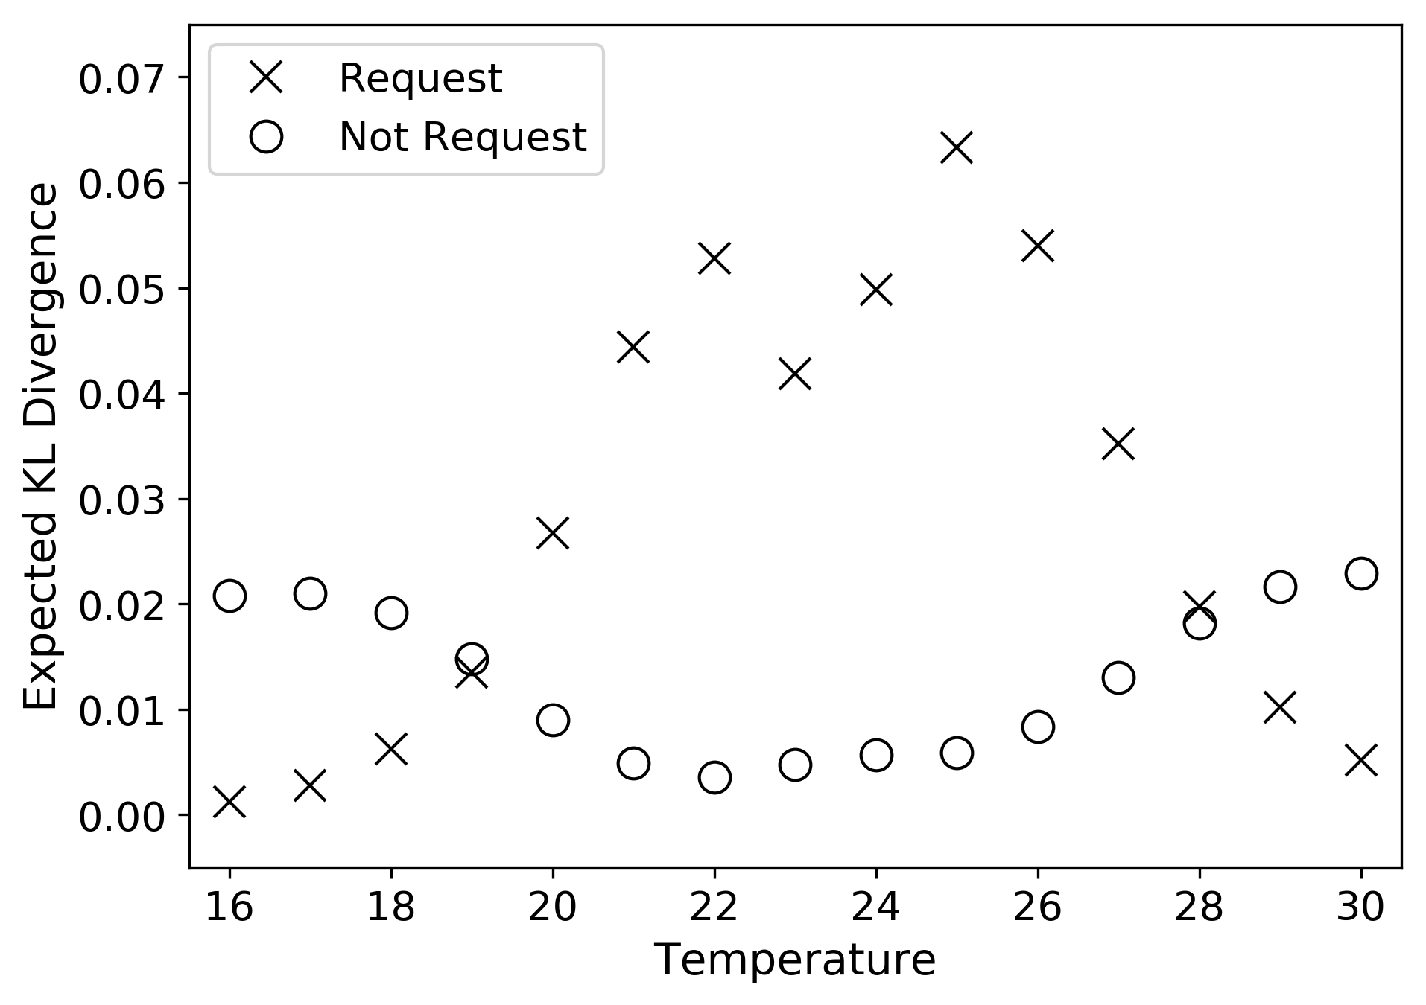
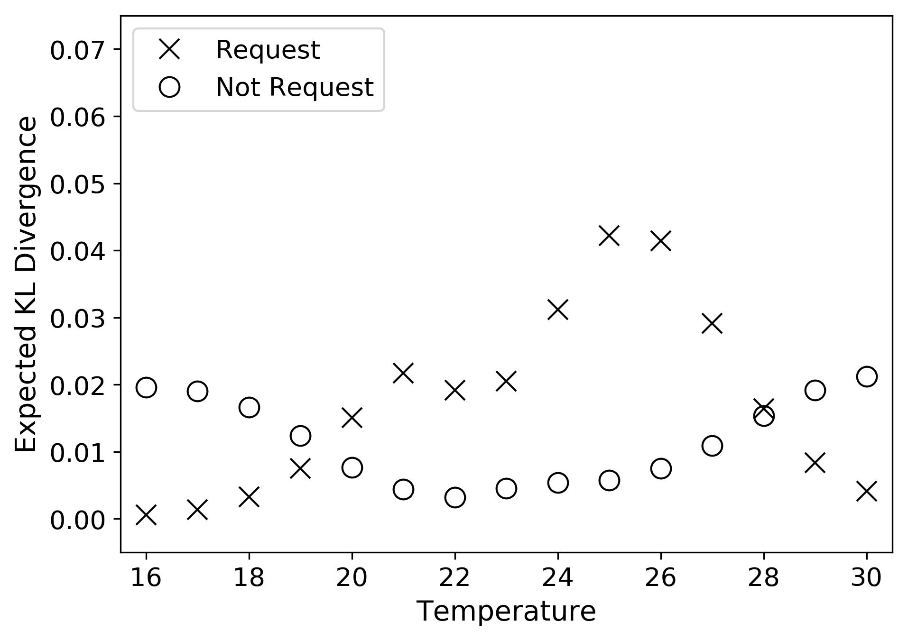
Smart Interface
Added seven requested responses collected between 21.5 - 22.5 °C
Subject 1
Subject 1
Value of a feedback request at given temperature changes
Expected information gain (expected KL divergence)
Expected information gain (expected KL divergence)

Slide 32
Thank you
Seungjae Lee
sjae.lee@utoronto.ca

